Slide 1

The Code Kitchen
Code Retreat – September 2025

Slide 2
Agenda
The Goal
Orders
Recipes
Pantry
Equipment
Timers
Communication
Rating

Slide 3
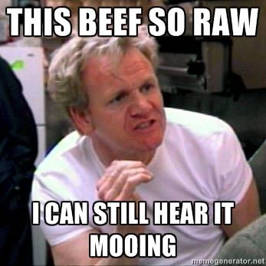
The Goal
Processing Orders
Cooking food
Teamwork!!!
Keeping our rating as high as possible
Notes:
Orders with requests will roll in
Recipes need to be followed, timing is crucial
In a kitchen, Communication is key!!!
We will work in Teams
Keeping the rating as high as possible is the goal

Slide 4
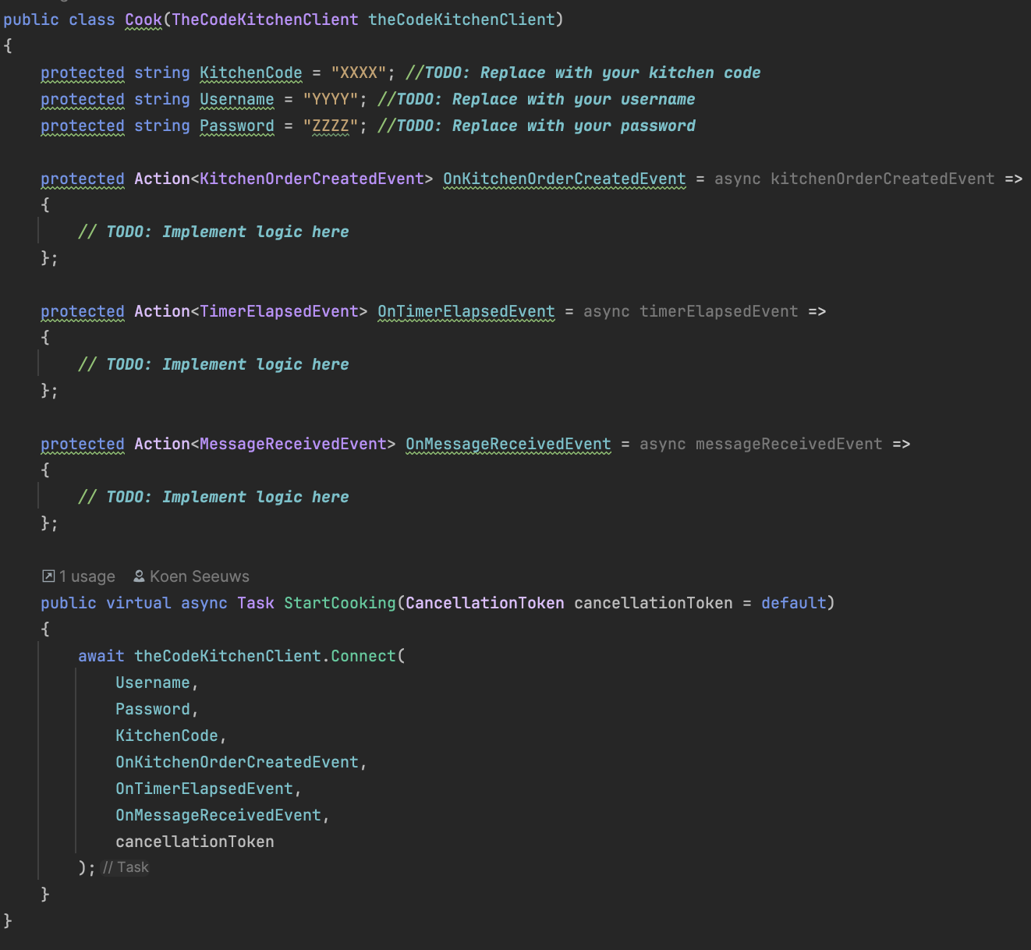
How?
Notes:
Template will be provided
Cook class needs to be implemented
There is allready client which: exposes endpoints, handles auth

Slide 5

Orders

Slide 6
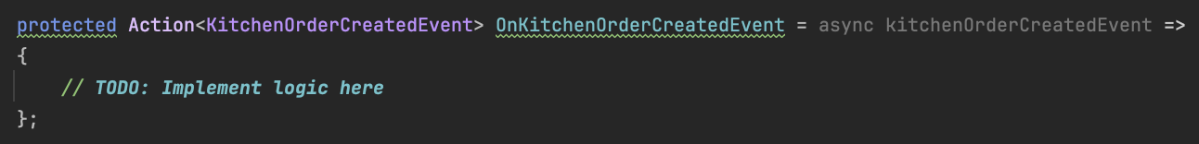
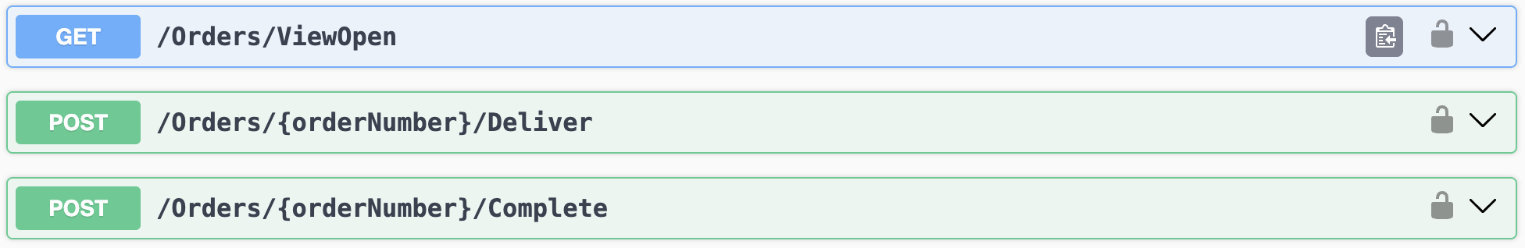
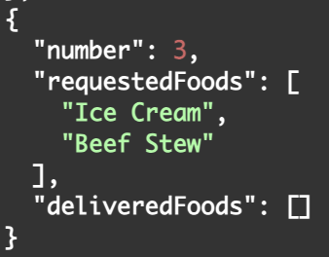
Orders
Identical for every kitchen
Always have a unique number within a kitchen

Slide 7
Recipes

Slide 8

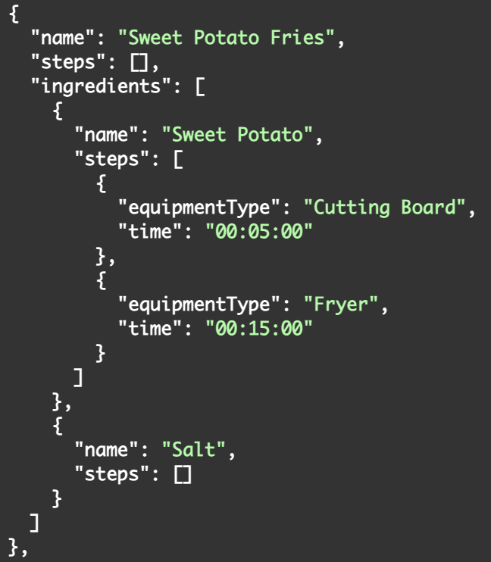
Recipes
Identical for everyone
*A recipe can also be the ingredient to another recipe!

Slide 9
Pantry

Slide 10
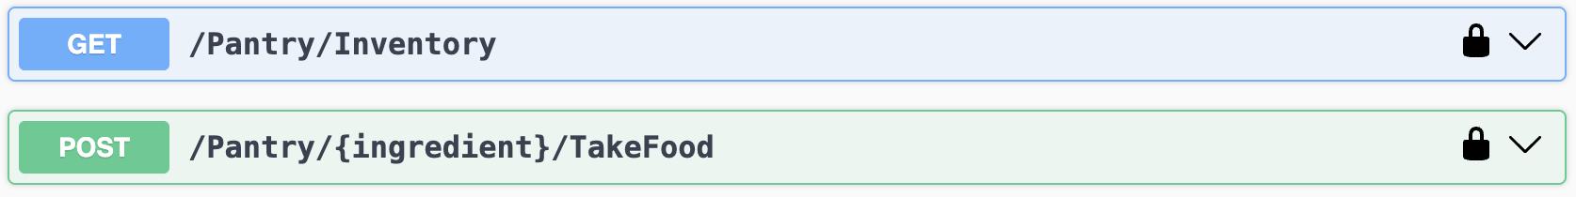
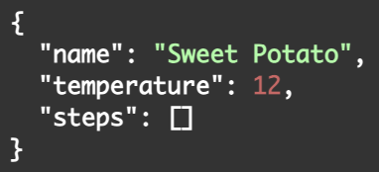
Pantry
Identical for everyone
Unlimited supply
Notes:
Unlimited

Slide 11
Equipment

Slide 12
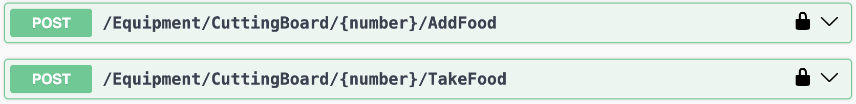
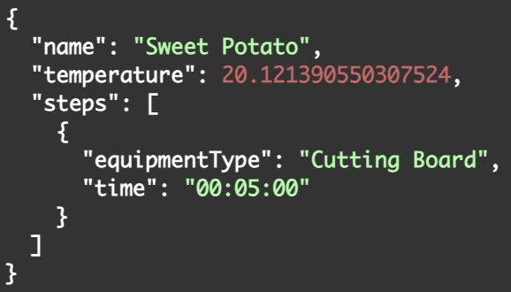
Equipment
Shared between everyone in a kitchen
When you take the food, you basicly mix all the added ingredients
*In case you make an unknown combination, you get an “UNKNOWN MIXTURE”
Notes:
Unlimited

Slide 13
Equipment
Amount of available equipment is limited
Number is zero-based
Type | Amount | Used in rating?
BBQ | 8 | Yes
Blender | 4 | Yes
Counter | 30 | No
Cutting Board | 10 | Yes
Freezer | 20 | Yes
Fridge | 20 | Yes
Fryer | 6 | Yes
Hot Plate | 15 | No
Mixer | 6 | Yes
Oven | 6 | Yes
Stove | 8 | Yes
Notes:
Unlimited

Slide 14
Timers

Slide 15
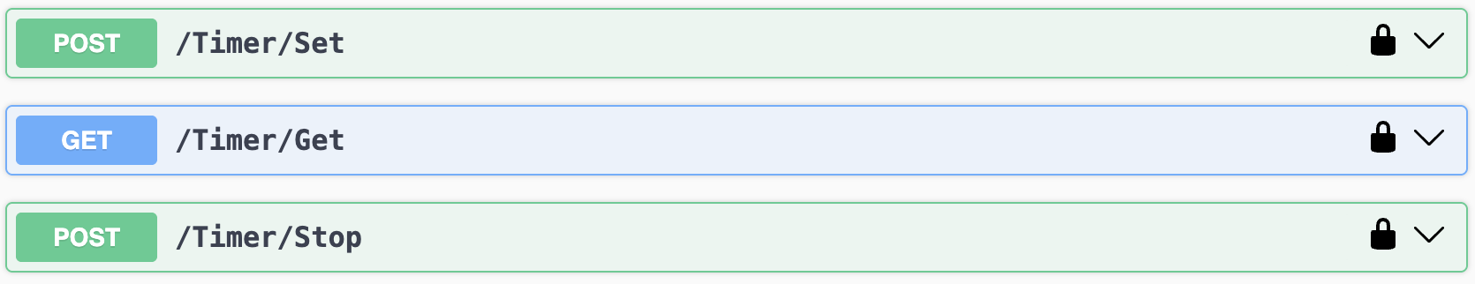
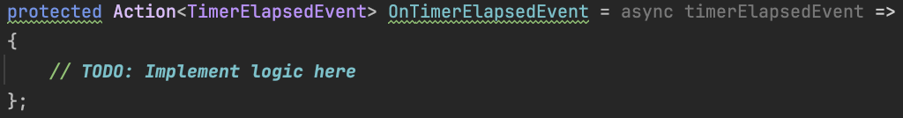
Timers
Timers are personal
Unique number for each cook
*In case a timer elapses, you only receive the event once
Notes:
Unlimited

Slide 16
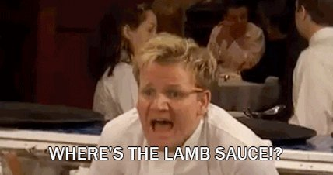
Communication

Slide 17
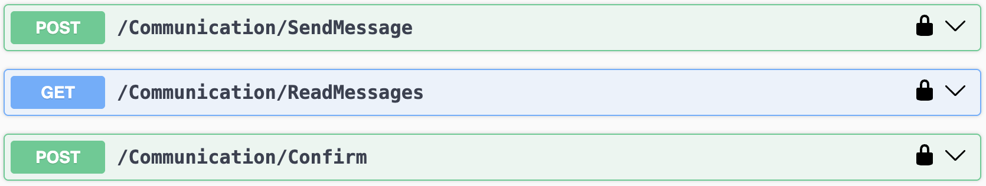
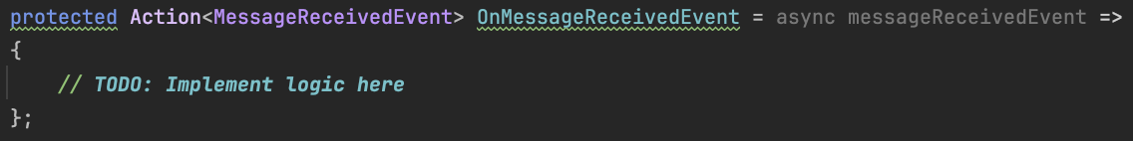
Communication
Message can be directed to another cook or everyone
To = “username other cook” directs the message to that cook
To = null directs the message to everyone except yourself
Unique number for each cook
Notes:
Unlimited

Slide 18
Trash

Slide 19

Trash
Simply throw away the food you are currently holding
Notes:
Unlimited

Slide 20
Rating

Slide 21
Rating
Your kitchen will be rated on three factors:
How long it takes to deliver food, the rating will go down if food starts to take too long (always with preparation times in mind)
Completeness of the orders
How well you followed the recipes
Notes:
Unlimited

Slide 22
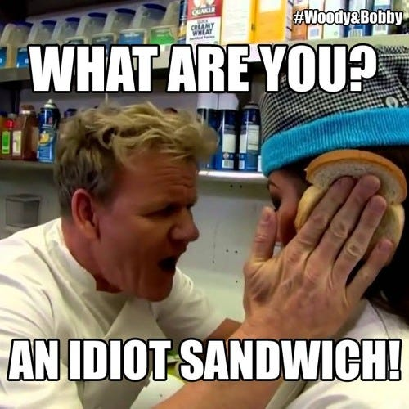
Questions?

Slide 23




@involved_it
Veldkant 35C, 2550 Kontich

